Slide 1
Distributed Web Based Systems

Slide 2
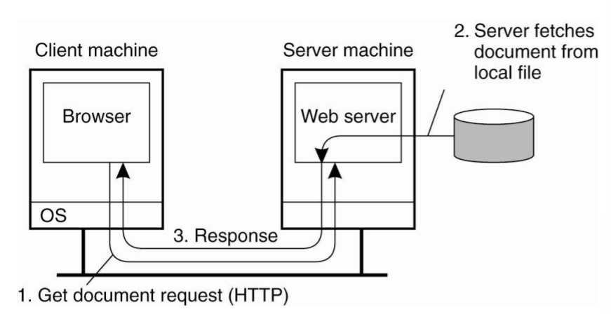
Traditional Web-Based Systems

Slide 3
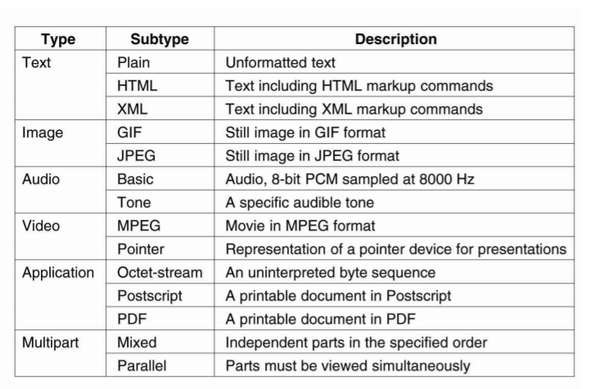
Web Documents

Slide 4
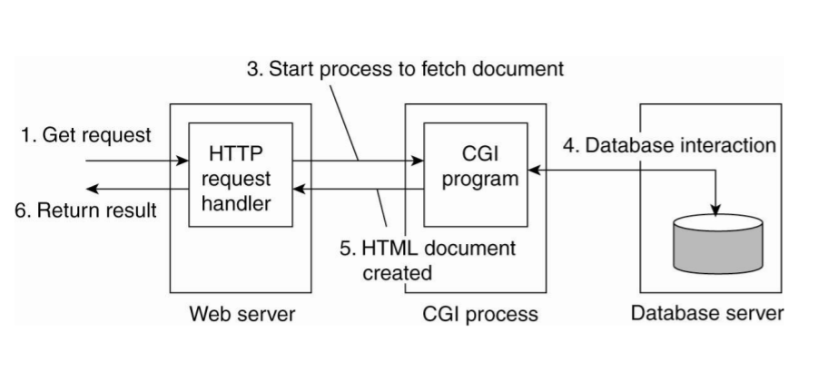
Multitiered Architectures

Slide 5
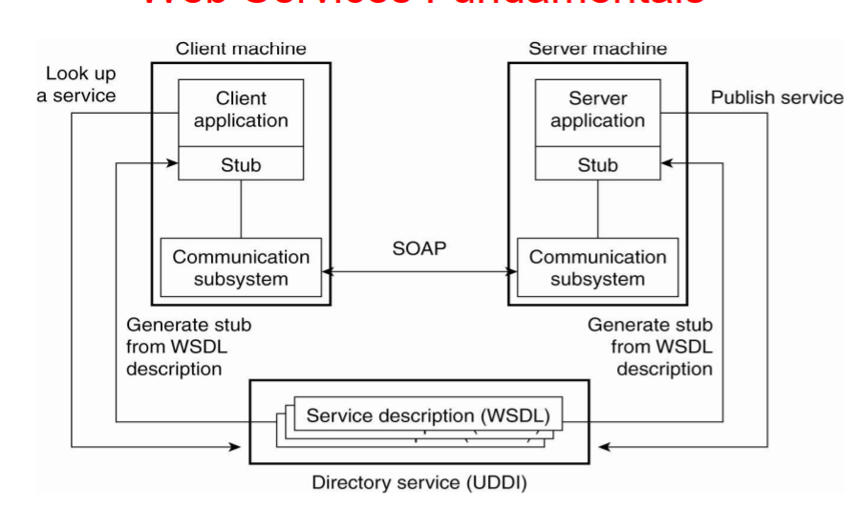
Web Services

Slide 6
Web Service Composition and Coordination
The architecture described so far is relatively straightforward: a service is implemented by means of an application and its invocation takes place according to a specific standard.
In the model so far, a Web service is offered in the form of a single invocation. In practice, much more complex invocation structures need to take place before a service can be considered as completed.

Slide 7
Processes
Clients
The most important Web client is a piece of software called a Web browser, which enables a user to navigate through Web pages by fetching those pages from servers and subsequently displaying them on the users’ screen.

Slide 8
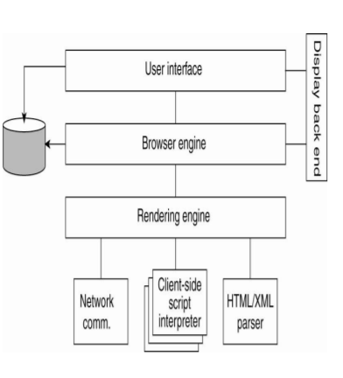
Processes – Clients

Slide 9
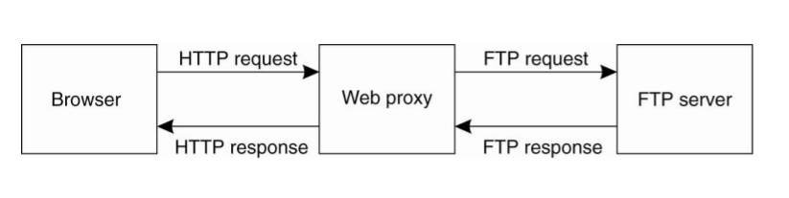
Processes – Clients

Slide 10
Processes
The Apache Web Server
By far the most popular Web server is Apache, which is estimated to be used to host approximately 70% of all Web sites.
Apache’s runtime environment, known as the Apache Portable Runtime (APR), is a library that provides a platform-independent interface for file handling, networking, locking, threads, and so on.

Slide 11
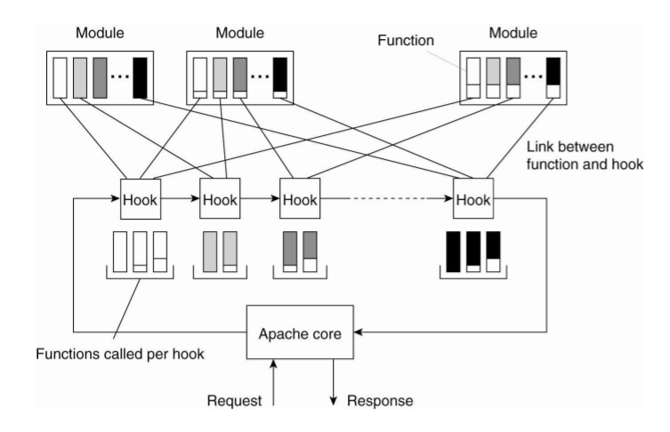
Processes – The Apache Web server

Slide 12
Processes
Web servers clusters
An important problem related to the client-server nature of the Web is that a Web server can easily become overloaded. A practical solution employed in many designs is to simply replicate a server on a cluster of servers and use a separate mechanism, such as a front end, to redirect client requests to one of the replicas

Slide 13
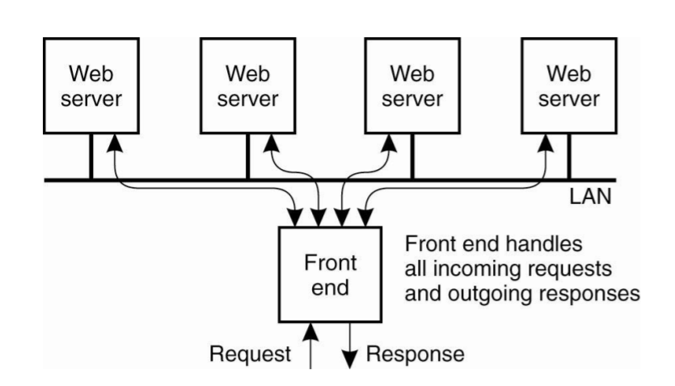
Processes-Web servers clusters

Slide 14
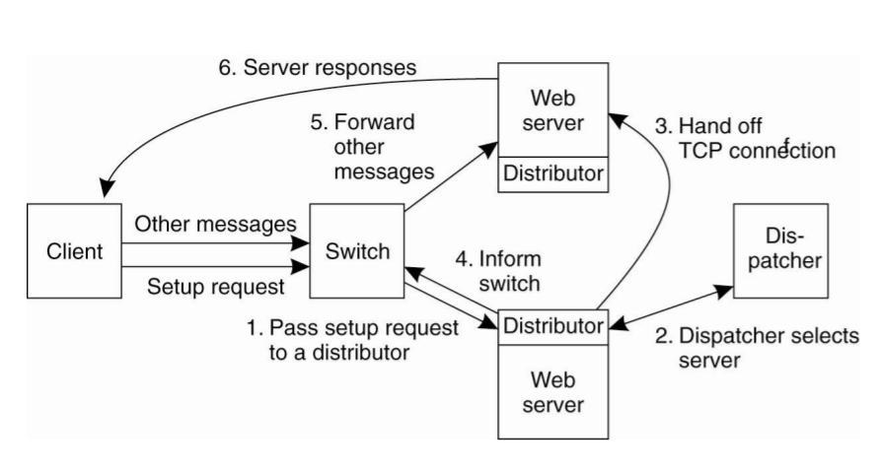
Processes-Web servers clusters

Slide 15
Communication
When it comes to Web-based distributed systems, there are only a few communication protocols that are used.
First, for traditional Web systems, HTTP is the standard protocol for exchanging messages.
Second, when considering Web Services, SOAP is the default way for message exchange.

Slide 16
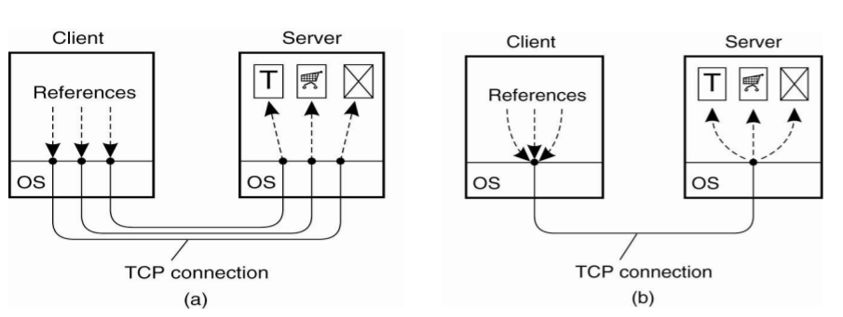
Communication
HTTP Connections

Slide 17
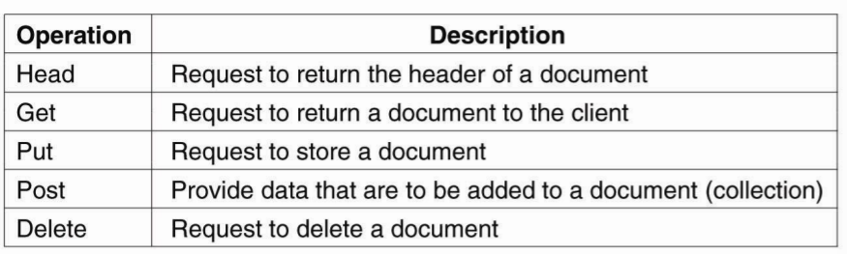
Communication
HTTP Methods

Slide 18
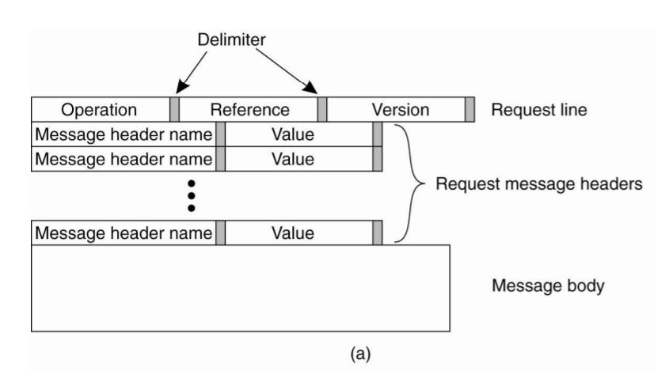
Communication
HTTP request Messages

Slide 19
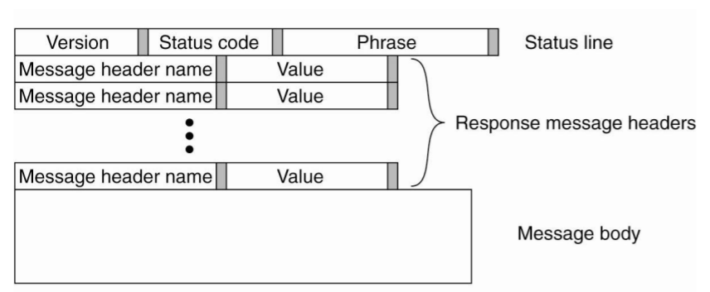
Communication
HTTP response Messages

Slide 20
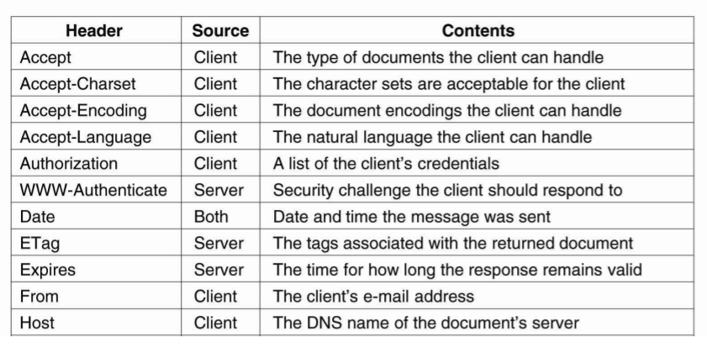
Communication
HTTP messages headers

Slide 21
Simple Object Access Protocol - SOAP
A SOAP message generally consists of two parts, which are jointly put inside what is called a SOAP envelope.
Everything in the envelope is expressed in XML, that is, the header and the body
At present, two such bindings exist: one to HTTP and one to SMTP, the internet Simple Mail Transfer Protocol.

Slide 22
Simple Object Access Protocol - SOAP
These two different types of bindings also indicate two different styles of interactions
Conversational exchange style
RPC-style

Slide 23
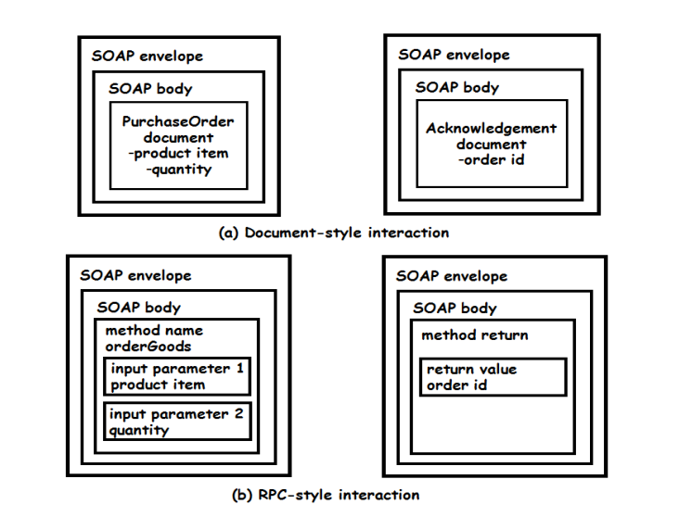
Simple Object Access Protocol - SOAP

Slide 24
Naming
The Web uses a single naming system to refer to documents. The names used are called Uniform Resource Identifiers or simply URIs (Berners-Lee et al., 2005) Uniform Resource Identifier (URI) come in two forms:
Uniform Resource Locator (URL)
a Uniform Resource Name (URN)

Slide 25
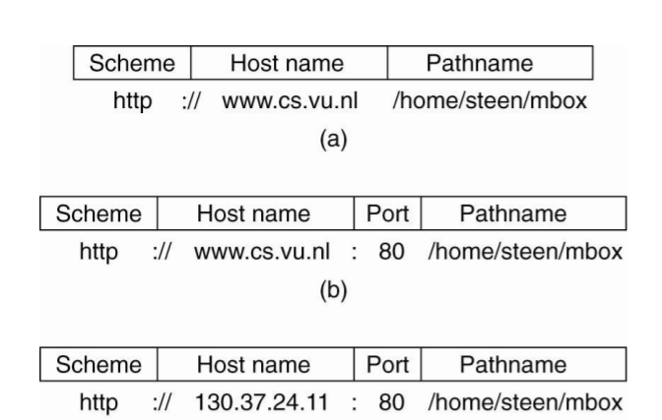
Naming

Slide 26
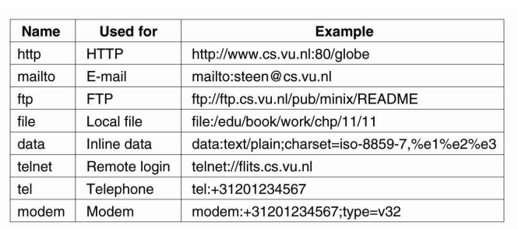
Naming

Slide 27
Synchronization
Synchronization is not much issue for most traditional web based system
Web should provide support for concurrent updates of document by group of collaborating user or processes
Web documents are handled through a separate protocol named WebDAV

Slide 28
Consistency and Replication
Client-side caching generally occurs at two places:
In the first place, most browsers are equipped with a simple caching facility
In the second place, a client's site often runs a Web proxy
Hierarchical cache
Cooperative caching

Slide 29
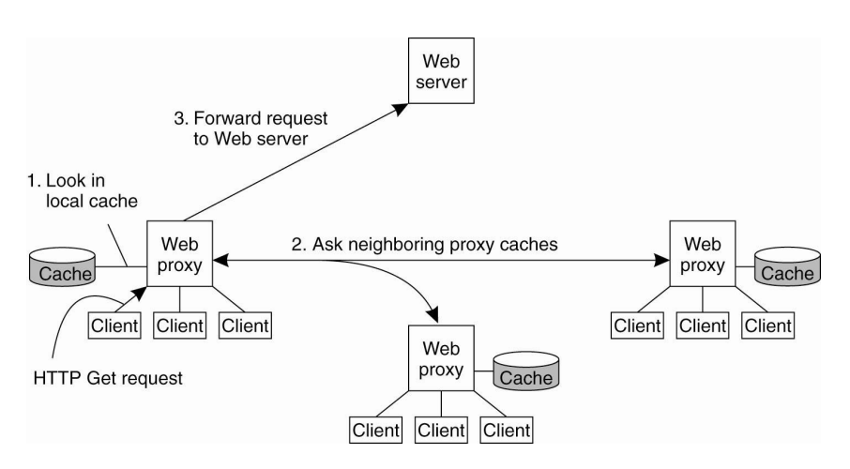
Consistency and Replication
Web proxy caching

Slide 30
Consistency and Replication
Web proxy caching
A comparison between hierarchical and cooperative caching by Rodriguez et al. (2001) makes clear that there are various trade-offs to make.
cooperative caches are generally connected through high-speed links, the transmission time needed to fetch a document is much lower than for a hierarchical cache.
Also, as is to be expected, storage requirements are less strict for cooperative caches than hierarchical ones.
Also, they find that expected latencies for hierarchical caches are lower than for distributed caches (Only for the cases that cached are on the web).

Slide 31
Replication for Web Hosting Systems
As the importance of the Web continues to increase as a vehicle for organizations to present themselves and to directly interact with end users, we see a shift between maintaining the content of a Web site and making sure that the site is easily and continuously accessible
This distinction has paved the way for Content Delivery Networks (CDNs).

Slide 32
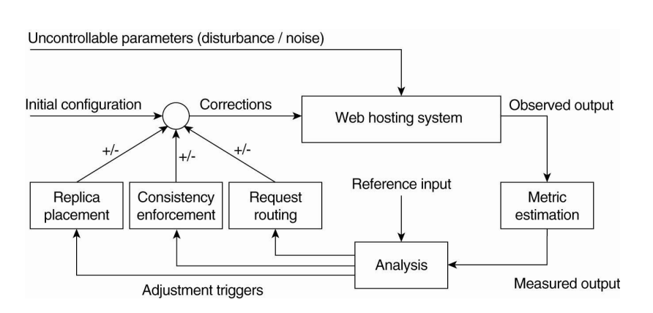
Replication for Web Hosting Systems

Slide 33
Replication for Web Hosting Systems
There are essentially three different kinds of aspects related to replication in Web hosting systems:
1) Metric estimation,
2) Adaptation triggering,
3) Taking appropriate measures:
A. Replica placement decisions
B. Consistency enforcement
C. Client-request routing.

Slide 34
CDN-Metric Estimation
A requirement of CDNs is that they need to make a trade-off between many aspects when it comes to hosting replicated content.
Latency metrics

Slide 35
CDN-Metric Estimation
Spatial metrics
Network usage
Consistency metrics
Financial metrics

Slide 36
Adaptation Triggering
Another question that needs to be addressed is when and how adaptations are to be triggered.
A simple model is to periodically estimate metrics and subsequently take measures as needed
A major drawback of periodic evaluation is that sudden changes may be missed.
One type of sudden change that is receiving considerable attention is that of flash crowds.

Slide 37
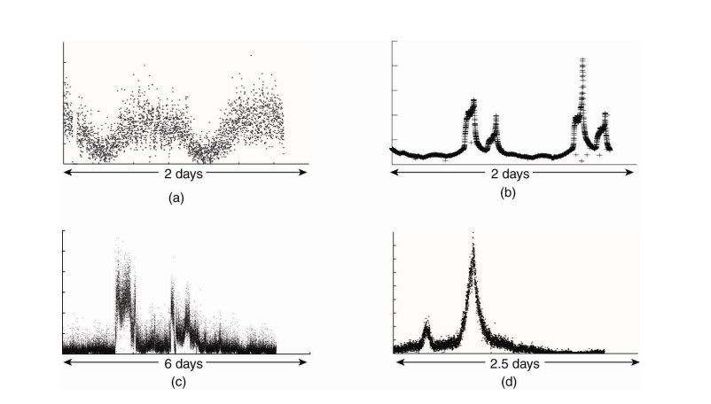
Adaptation Triggering

Slide 38
CDN-Adjustment Measures
There are essentially only three (related) measures that can be taken to change the behavior of a Web hosting service:
Changing the placement of replicas
Changing consistency enforcement
Deciding on how and when to redirect client requests.

Slide 39
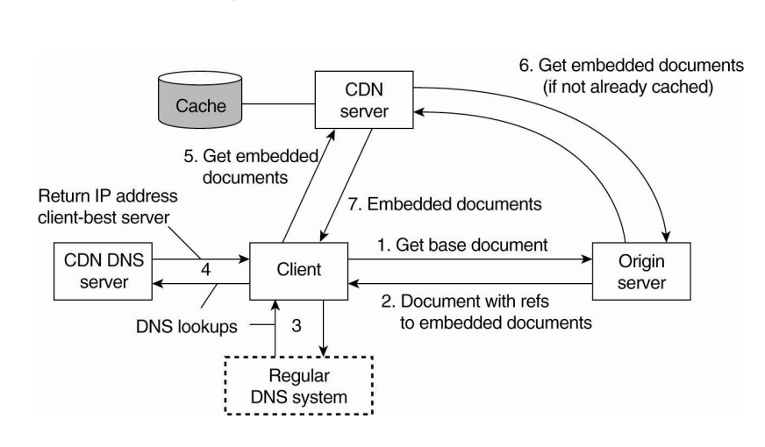
CDN-Adjustment Measures

Slide 40
CDN-Adjustment Measures
Besides the different policies, an important issue is whether request redirection is transparent to the client or not. In essence, there are only three redirection techniques
TCP handoff,
DNS redirection,
HTTP redirection

Slide 41
Replication of Web Applications
Up to this point we have mainly concentrated on caching and replicating static Web content. In practice, we see that the Web is increasingly offering more dynamically generated content, but that it is also expanding toward offering services that can be called by remote applications

Slide 42
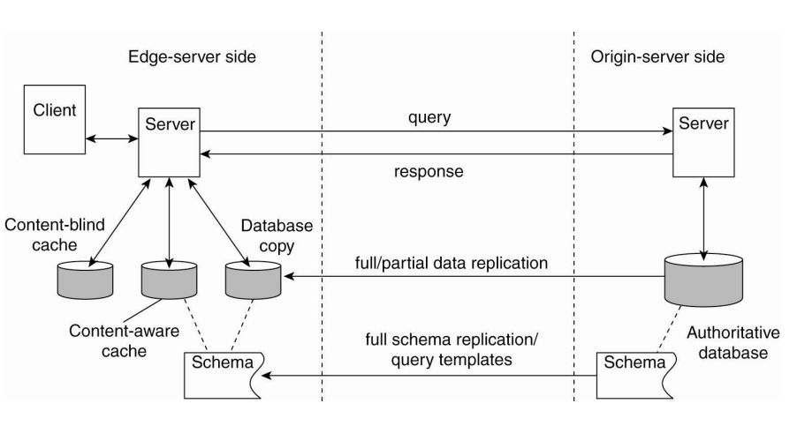
Replication of Web Applications

Slide 43
Replication of Web Applications
First, to improve performance, we can decide to apply full replication of the data stored at the origin server.
Second case for full replication is when queries are generally complex.
An alternative to partial replication is to make use of content-aware caches.
With content-aware caches, an edge server maintains a database that is organized according to the structure of queries. What this means is that queries are assumed to adhere to a limited number of templates, effectively meaning that the different kinds of queries that can be processed is restricted.

Slide 44
Context-aware caches
Part of the complexity of content-aware caching comes from the fact that the data at the edge server needs to be kept consistent.
To this end, the origin server needs to know which records are associated with which templates, so that any update of a record, or any update of a table, can be properly addressed by, for example, sending an invalidation message to the appropriate edge servers

